Slide 1

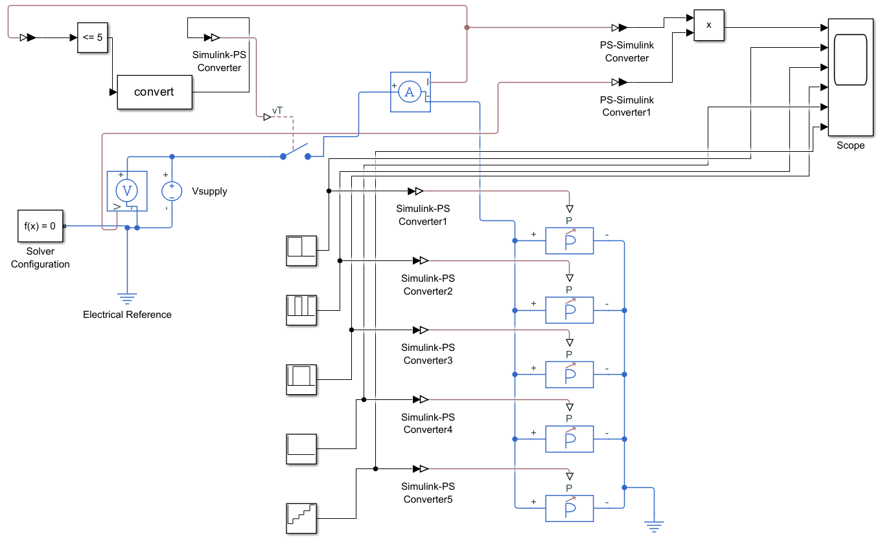
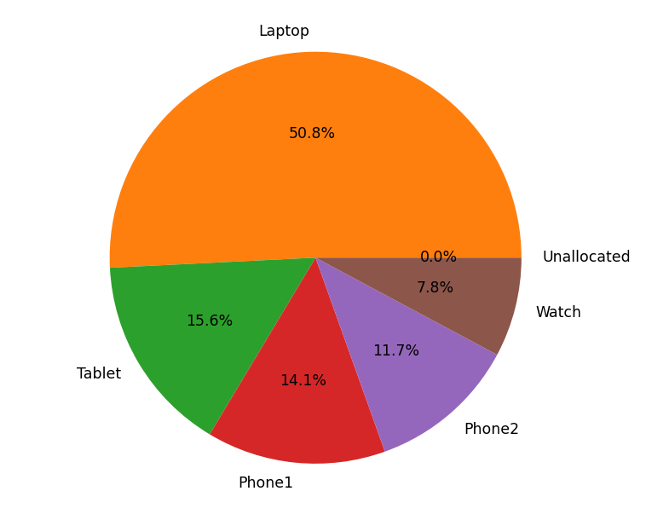
PowerSlice: Supplying A World of New Devices
Ryan Rosenberger
Overview
Results
Conclusions
PowerSlice is a portable, compact USB power splitter for portable electronic devices
Takes an input from USB PD supply and divides it between connected devices
Initial management system able to balance power between theoretical devices
More development needed to add different charging schemes and handle nonidealities of real system
Methods
Next Steps
Initial goal of building a physical prototype of the power splitter
Physical implementation would be expensive in terms of money and time
Pivoted to solving arbitration problem between connected devices
How do multiple devices share a limited power source?
Initially modelled power flow in a hypothetical system with multiple loads
Developed a Python script to balance power between devices
MATLAB Simulink Power Flow Model
Add priority assignment capability, be able to funnel all power to one or more specific devices
Handle real power variations, nonidealities of converters and losses in device
Handle different charge rates, reallocating power as devices go through their charge cycles
Once arbitration system is complete, can move onto physical realization of device
Python Device Power Manager

